Slide 1
SOEN 384
Management, Measurement and Quality Control
Tutorial: Logiscope
Tutor: Ming Zhu
Zhijie Xie

Slide 2
The Logiscope Toolset
Logiscope QualityChecker
  Quality Evaluations & Graphical Code Views
Logiscope RuleChecker
  Automated Coding Rule Checking
Logiscope TestChecker
  Structure-based Testing & Test Coverage Analysis
Logiscope Code Reducer
  Find Code Similarities Remove Duplicated Code

Slide 3
Logiscope QualityChecker
Provides metrics and graphical representations of the source code
Provides over 190 quality metrics
Quality model can be tailored to Project / Company.
Context-free file parsing for C, C++ and Java.
automated Reporting facilities (HTML, WORD)

Slide 4
Quality Modeling
The modeling approach used by Logiscope is compliant with the ISO/IEC 9126-1 Software engineering — Product quality (previous version of ISO/ICE 25010)
software quality can be defined as a set of characteristics:
  are important to the user: quality factors,
  can be decided by the designer: quality criteria,
  can be measured for verification purposes: quality metrics.

Slide 5
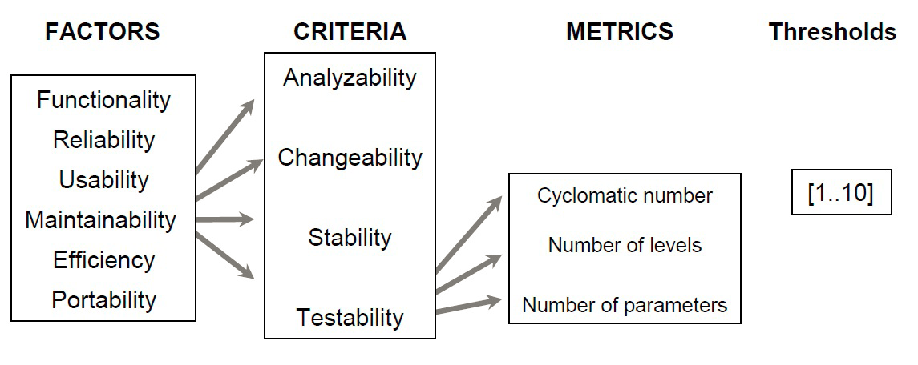
Quality Modeling
Metrics: comparison of measured values with limit values previously defined in the Quality Model
criteria: classification in different categories according to results obtained for metrics
quality factor: classification in different categories according to results obtained at criteria level

Slide 6
Quality Modeling
Source code metrics apply to different scope. The scope of a metric designates the element of the source code the metric will apply to.
The different scopes are:
  The Function scope: includes functions, procedures, methods,, etc.
  The Class scope: is represented by C++ and Java classes.
  The Module scope: is represented by a source code file.
  The Package scope: is represented by Java Packages; Packages contain a set of classes.
  The Application scope: represented by the set of interrelated software components

Slide 7
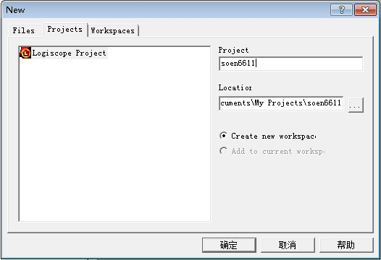
Create a new Project
  1. login to Windows
  2. Search Logiscope
  3. Choose Kalimetrix Logiscope

Slide 8
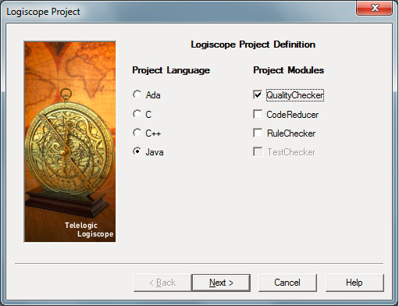
Project Definition

Slide 9
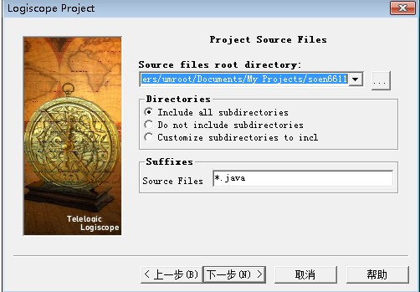
Indicate Project Source Files

Slide 10
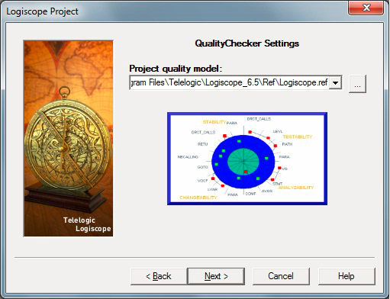
Choose your project quality model

Slide 11
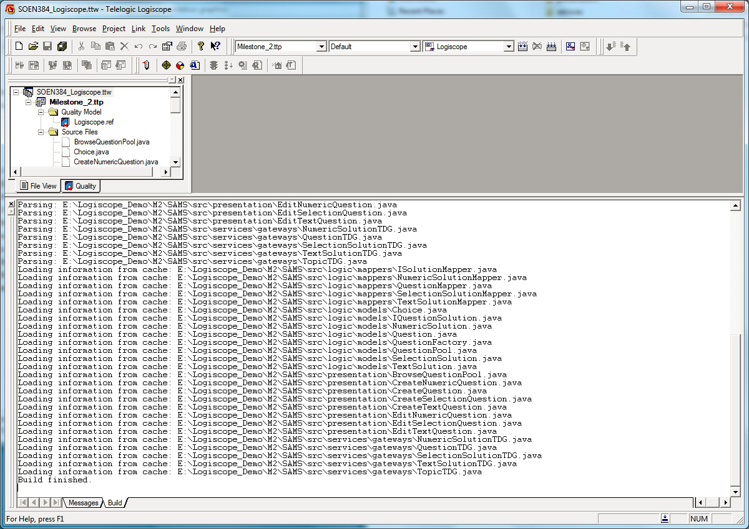
Build Project

Slide 12
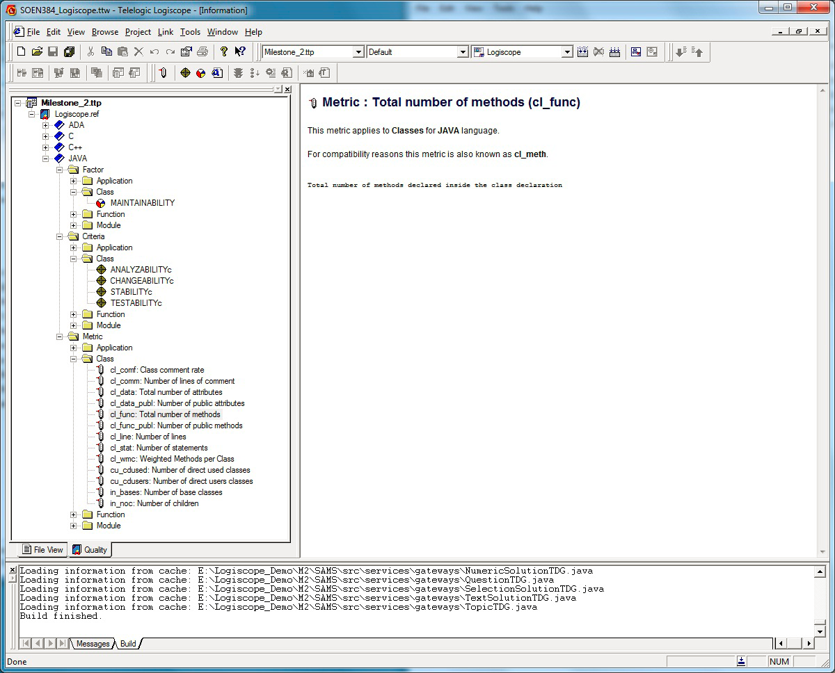
Quality Model

Slide 13
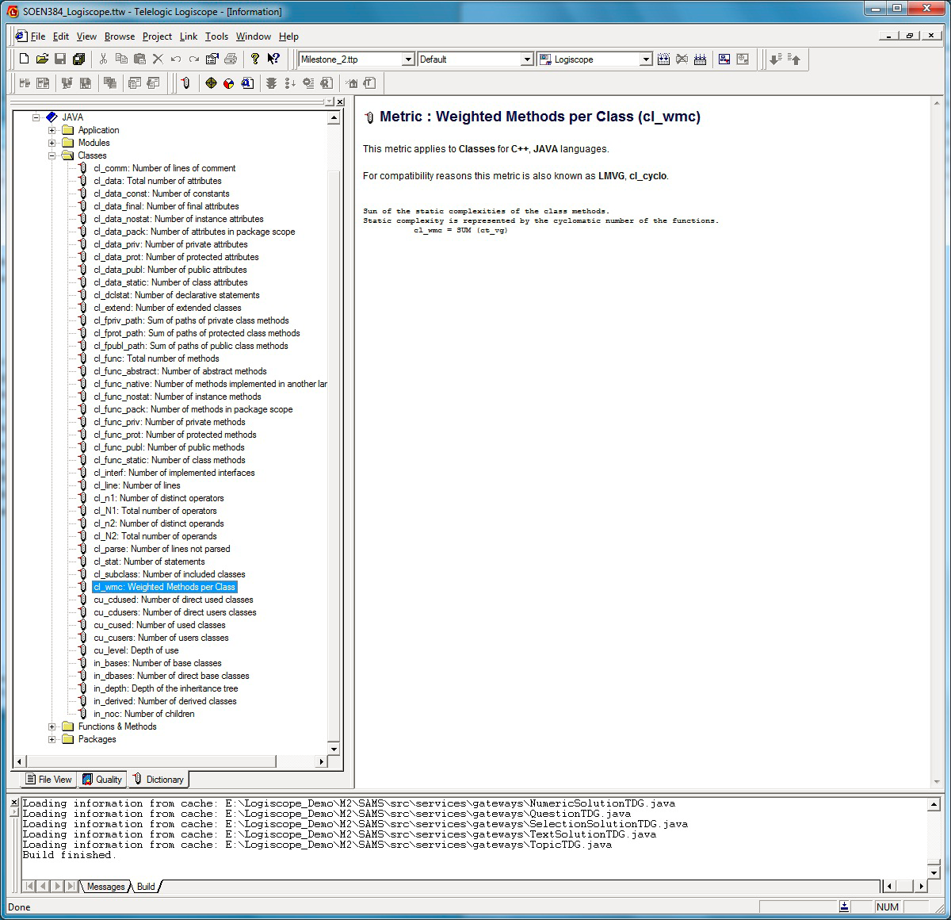
Metrics Dictionary

Slide 14
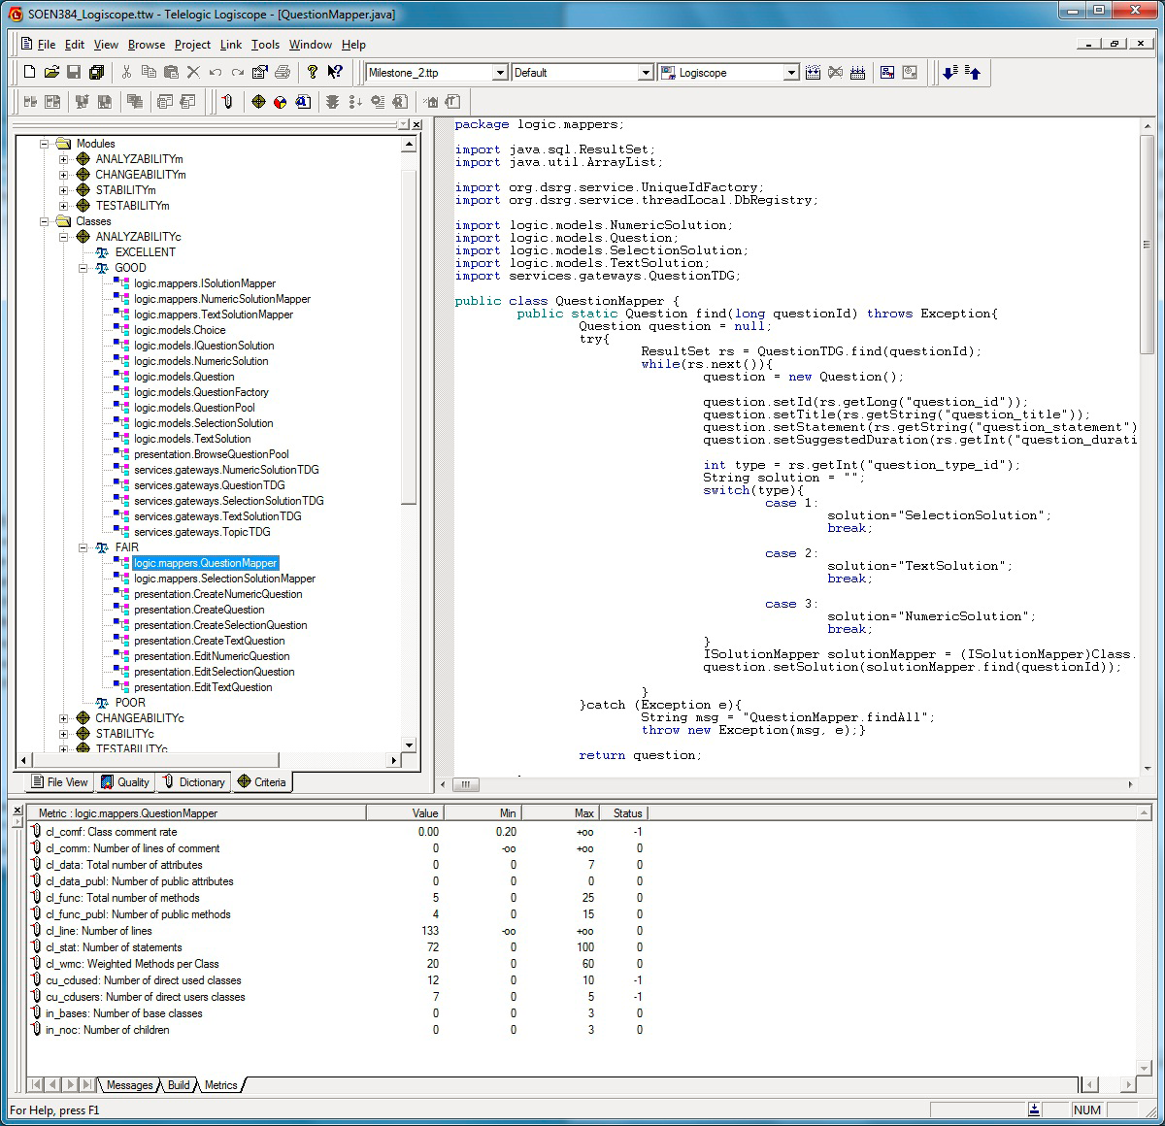
Criteria Level

Slide 15
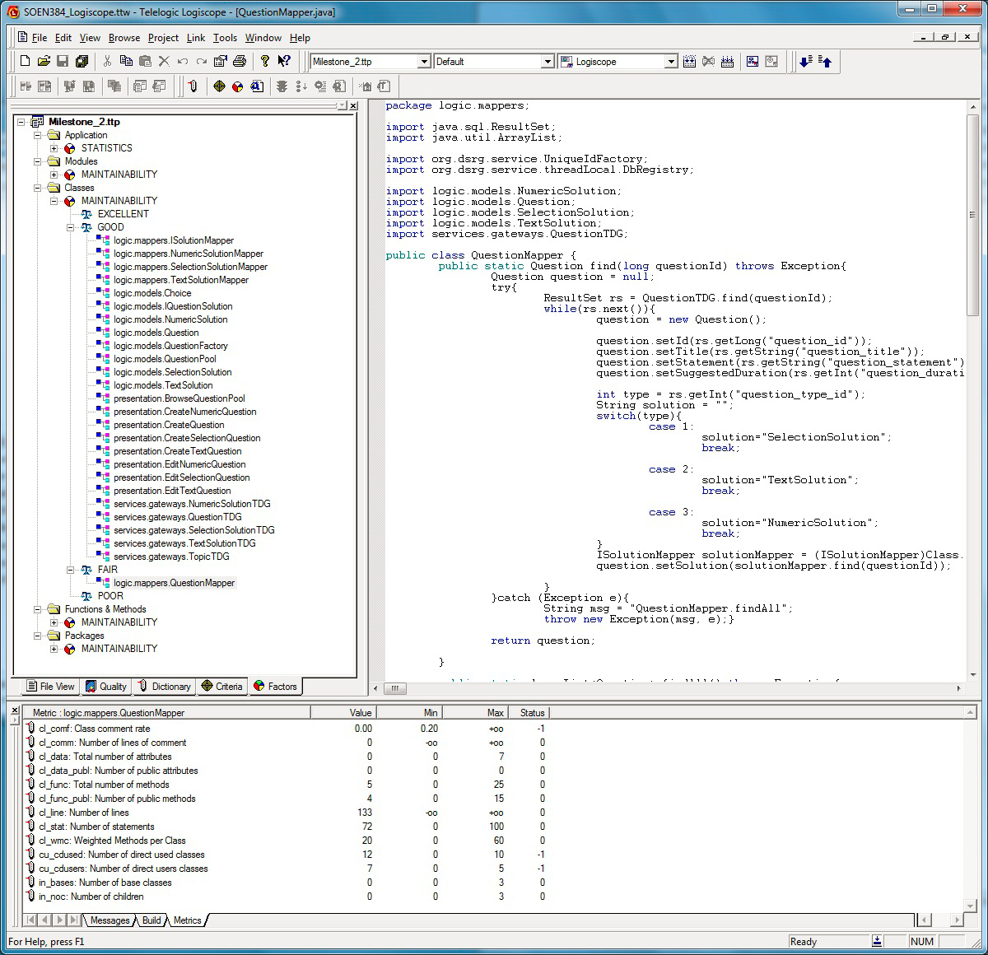
Factor Level

Slide 16
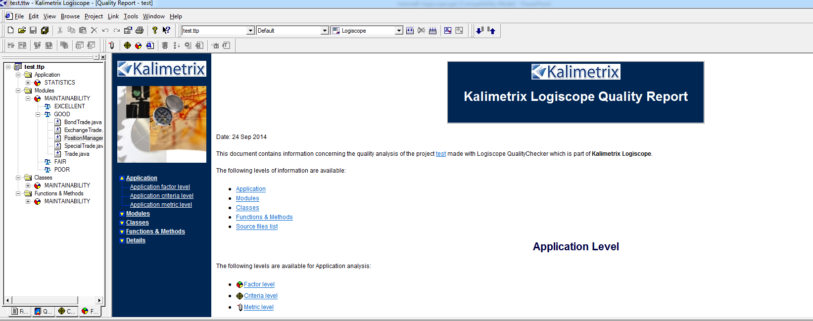
Quality Report

Slide 17
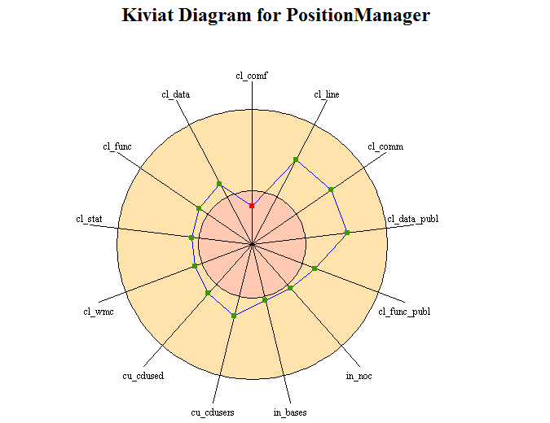
Kiviat Diagram

